Slide 1
City of Lincoln Strategic Planning Retreat
Friday, March 6, 2015

Slide 2
Demographic Profile

Slide 3
City of Lincoln Demographics
 | # | % |  | # | % |  | % Change
Total population | 14,504 | 100% |  | 14,323 | 100% |  | -1.2
35 to 44 years | 1,543 | 11% |  | 1,284 | 9% |  | -16.8
60 to 64 years | 791 | 5% |  | 933 | 7% |  | 18.0
White | 13,721 | 95% |  | 13,299 | 93% |  | -3.1
Black or African American | 696 | 4.8% |  | 820 | 6% |  | 17.8
Hispanic or Latino (of any race) | 336 | 2% |  | 179 | 1% |  | -46.7
 | 2000 |  |  | 2009-2013 est.
MEDIAN HOUSEHOLD INCOME | $ |  |  | $ |  |  | % Change
Lincoln | $ 34,435 |  |  | $ 38,871 |  |  | 12.9
Illinois | $ 46,590 |  |  | $ 56,797 |  |  | 21.9
Source: 2010 Census and 2009-2013 American Community Survey 5-Year Estimates

Slide 4
Comparisons
PEOPLE | LINCOLN | SPRINGFIELD | PEORIA | DECATUR | CHAMPAIGN | URBANA | BLOOMINGTON | NORMAL | ILLINOIS
Population, percent change - April 1, 2010 (estimates base) to July 1, 2013, (V2013) | -1.5 | 0.6 | 1.3 | -1.8 | 2.9 | 0.7 | 3 | 4.1 | 0.4
Persons 65 years and over, percent, April 1, 2010 | 17.6 | 14.3 | 13.1 | 16.9 | 7.6 | 8.7 | 10 | 8.2 | 12.5
White alone, percent, April 1, 2010 (a) | 92.9 | 75.8 | 62.4 | 71.6 | 67.8 | 60.4 | 77.5 | 85.1 | 71.5
Bachelor's degree or higher, percent of persons age 25 years+, 2009-2013 | 18.4 | 34.1 | 32.7 | 20.4 | 49.4 | 55.3 | 45.7 | 49.4 | 31.4
In civilian labor force, total, percent of population age 16 years+, 2009-2013 | 59.4 | 65.4 | 63.7 | 60.1 | 63.3 | 59.8 | 71.3 | 67.5 | 66.2
Median household income (in 2013 dollars), 2009-2013 | $38,871 | $49,317 | $45,270 | $39,514 | $40,884 | $29,879 | $61,664 | $53,720 | $56,797
Median value of owner-occupied housing units, 2009-2013 | $90,700 | $116,900 | $122,100 | $81,800 | $149,500 | $149,600 | $161,000 | $160,100 | $182,300
Median selected monthly owner costs -with a mortgage, 2009-2013 | 956 | 1,162 | 1,190 | 960 | 1,328 | 1,263 | 1,435 | 1,447 | 1,701
Persons without health insurance, under age 65 years, percent | 11.1 | 12.4 | 13.8 | 16 | 11.5 | 9.6 | 9.8 | 6.8 | 14.5
Total retail sales per capita, 2007 (c) | $16,817 | $20,214 | $16,665 | $14,608 | $17,203 | $11,388 | $17,908 | $12,380 | $12,947

Slide 5
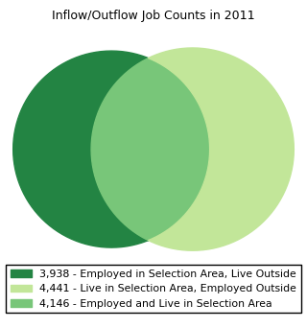
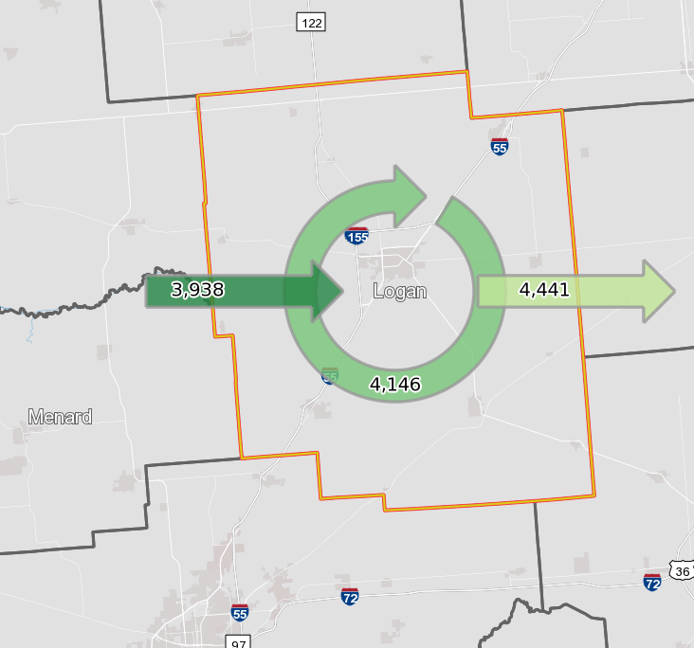

Slide 6
Lincoln and Logan County –
Where (and who) we are demographically
Keith Snyder
Lincoln City Council Strategic Planning
March 2015

Slide 7
Lincoln/Logan County Demographic Trends – Population over past 100 years (Source: Census data)
Notes:
Logan County –
Up 3/10ths of one percent since 1910.
Peak was 1960.
Up 16.6% from 1930 to 1960.
Down 10% since 1960.
Lincoln –
Up 33% since 1910.
Peak issues, like County.
City’s peak was 1970.
Grew 61% from 1910 to 1970.
Shrunk 17% since 1970.

Slide 8
30-Year Change: Lincoln from
1980 to 2010
(Source: Census data)
 | 1980 | 2010 | % Change
Overall Population | 16,327 | 14,504 | -11.17%
Male | 7,666 | 6,948 | -9.37%
Female | 8,661 | 7,556 | -12.76%
Median Age | 31.5 | 38.0 | 20.63%
Age 19 & below | 4,790 | 3,815 | -20.35%
Age 80 & above | 675 | 933 | 38.22%
Notes:
30-year drop of 11.17%.
Female population has dropped more than male.
Median age grew 6.5 years since 1980. That is seen at the lower and higher end of our ages –
19 & younger dropped over 20%
80 & older grew over 38%
In 2010, the median age in Illinois was 36.6 years.
2014 Update from Retail Strategies:
2014 population: 14,227 (drop of almost 2%)
19 & under: 3,611 (drop of 5%)
65+: rose from 2,589 to 2,648 (increase of 2.2%)

Slide 9
10-Year Change: Lincoln from 2000 to 2010 (Source: Census data)
Industry | 2000 | 2010 | Change
Agriculture | 1.1% | 1.1% | 0.0%
Construction | 4.9% | 5.7% | 0.8%
Manufacturing | 15.6% | 12.8% | -2.8%
Wholesale | 1.2% | 3.3% | 2.1%
Retail | 11.5% | 10.9% | -0.6%
Transportation & Warehousing | 4.0% | 5.9% | 1.9%
Information | 2.0% | 2.2% | 0.2%
Finance, Insurance | 5.0% | 7.7% | 2.7%
Professional, Scientific | 3.2% | 11.0% | 7.8%
Education | 27.6% | 22.1% | -5.5%
Arts, Entertainment | 8.1% | 8.7% | 0.6%
Public Administration | 10.3% | 3.9% | -6.4%
Other | 5.6% | 4.8% | -0.8%
Private Pay | 75.2% | 82.0% | 6.8%
Government Workers | 19.8% | 12.9% | -6.9%
Self-Employed | 4.7% | 5.0% | 0.3%
Median Household Income | 2000 | 2010 | % Change | AGR
Lincoln | $34,435 | $39,826 | 15.66% | 1.42%
Illinois | $46,435 | $56,576 | 21.84% | 1.99%
Notes:
This is a look at Lincoln from a jobs & economics perspective over the last 10 years.
Interesting to see what industries had the largest drops: Manufacturing; Education; Public Administration. The latter two industries require at least some college.
Industries with increases:
Finance, Insurance, and Real Estate
Professional, Scientific, Management, Administrative, and Waste Management (?)
Industry groupings: Government workers were 1 in 5 in 2000; jumped to 1 in 8 in 2010.
Median household income in Lincoln increased, but at a slower rate than the State of Illinois.
“AGR” = Annual Growth Rate
Lincoln’s MHI was 28.5% below Illinois’ in 2000. It was 29.5 below Illinois’ in 2010.
While it would take the average Illinois citizen 36.2 years to double his/her household income at an annual growth rate of 1.99%, it would take an average Lincoln resident 50.7 years to double their household income at a rate of 1.42% per year.

Slide 10
Lincoln compared to drive-to communities – 10-Yr. Pop. Change
(Source: Census data)
 | 2000 Pop. | 2010 Pop. | Change | % Change
Champaign-Urbana | 104,069 | 122,295 | 18,226 | 17.51%
Bloomington-Normal | 110,383 | 129,107 | 18,724 | 16.96%
Springfield | 112,201 | 116,250 | 4,049 | 3.61%
Peoria | 112,892 | 115,007 | 2,115 | 1.87%
Lincoln | 15,369 | 14,504 | -865 | -5.63%
Decatur | 82,113 | 76,122 | -5,991 | -7.30%
Notes:
It’s probably no coincidence that both Champaign-Urbana and Bloomington-Normal have large public universities.

Slide 11
Logan County compared to 11-county economic region – Population change
(Source: Census data)
Area | 1990 Pop. | 2000 Pop. | 2010 Pop. | Change (2000-2010) | % Change (2000-2010)
McLean County | 129,180 | 150,433 | 169,572 | 19,139 | 12.72%
Champaign County | 173,025 | 179,669 | 201,081 | 21,412 | 11.92%
Tazewell County | 123,692 | 128,485 | 135,394 | 6,909 | 5.38%
Sangamon County | 178,386 | 188,951 | 197,465 | 8,514 | 4.51%
Piatt County | 15,548 | 16,365 | 16,729 | 364 | 2.22%
Menard County | 11,164 | 12,486 | 12,705 | 219 | 1.75%
Peoria County | 182,827 | 183,433 | 186,494 | 3,061 | 1.67%
DeWitt County | 16,516 | 16,798 | 16,561 | -237 | -1.41%
Logan County | 30,798 | 31,183 | 30,305 | -878 | -2.82%
Macon County | 117,206 | 114,706 | 110,768 | -3,938 | -3.43%
Mason County | 16,269 | 16,038 | 14,666 | -1,372 | -8.55%
11-county area | 994,611 | 1,038,547 | 1,091,740 | 53,193 | 5.12%
State of Illinois | 11,440,602 | 12,419,293 | 12,830,632 | 411,339 | 3.31%
Notes:
Our 11-county economic region is every county that touches Logan plus Peoria to the north and Piatt and Champaign to the east. This region encompasses all of the drive-to communities listed earlier.
It’s an economically-connected region. There is cross-commuting. People driving to and from each county from/to Logan.
Almost 1.1 million in size.
Has a Gross Domestic Product of $50 billion/year.
Lincoln is the hub of this dynamic region. Rather than “competing” or “comparing” ourselves to the entire State, it makes the most sense to compare ourselves to the region in which we live and work.
On population alone, our economic region grew 5% while Logan County shrank almost 3%.
The next few slides compare Lincoln and Logan County to this region, our State of Illinois, and the nation.

Slide 12
Percentage of Population Aged 65+
Source: 2010 Census
Notes:
The lowest percentages in the region:
Champaign 10.2%
McLean 10.4%
Peoria 14%
Sangamon 14%
Highest percentages:
Mason 19.7%
De Witt 17.1%
Piatt 16.7%
2014 Update from Retail Strategies: 18.6% in 2014

Slide 13
Percentage of Population Age 25+ with a Bachelor’s Degree or higher
(Source: 2010 Census)
Notes:
Highest county percentages:
Champaign 42.1%
McLean 41.1%
Sangamon 31.2%
Peoria 28.3%
Almost 1/3 of the people in our economic region have bachelor’s degrees. In Lincoln that number is only 20% despite being rich in higher education opportunities (LC, LCU, & Heartland on site; ISU, Bradley, and UIS close by).

Slide 14
Percentage of Population Below the Poverty Level
(Source: 2010 Census)
Notes:
Highest county percentages:
Champaign 21.8%
Mason 15.5%
Peoria 15.4%
Lowest percentages:
Piatt 6.5%
De Witt 7.9%
Menard 7.9%
2014 Update from Retail Strategies:
In 2014, 14.9% of households had incomes less than $15,000

Slide 15
Average Number of Persons per Household
(Source: 2010 Census)
Notes:
Interesting statistical measure. The higher the number, the more likelihood of having households with three or more members (i.e., families). One- or two-resident households = singles, couples, empty-nesters, widowed.
A population with fewer households of children = a population less likely to sustain long-term growth.
2014 update from Retail Strategies: (3 mi drive time)
2014 avg household size of 2.27; down from 2.29 in 2010.

Slide 16
ERSI Tapestry: Population Segmentation
The nine segments found within a 3 mi. radius of Lincoln (2014):
Heartland Communities (29%) – “Few college grads; cherish their modest homes and care for their gardens”
Midlife Constants (23%) – “Transitioning from child-rearing to retirement”
Rustbelt Traditions (19%) – “Stick close to home; not tempted by fads”
Old and Newcomers (14%) – “Transitional; either starting careers or retiring; >60% are renters”
Hardscrabble Road (6%) – “1 in 3 have incomes below poverty; unemployment is twice national average; struggling to get by”
Traditional Living (6%) – “Settled neighborhoods in Midwest; cost conscious; loyal to brands”
In Style (3%) – “Professional couples; live in affluent neighborhoods”
Prairie Living (1%) – “Live on family properties in Midwest”
Salt of the Earth (1%) – “Settled, traditional, hard-working, reliant”
Notes:
ESRI is a company that provides software, data, and other tools to analyze spatial information. “Tapestry” uses demographic and consumer behavior information (i.e., what we spend our money on and where) to divide households into 66 household segments. Each segment feeds into 1 of 14 Life Mode Groups. These segments & their grouping paints a fuller picture of the people who make up a community and is used for targeted marketing campaigns.
2014 data from Retail Strategies. The percentages add to 101% due to rounding.
A phrase describing each of the segments is included.

Slide 17
ERSI Tapestry: Population Life Groups
Logan County’s nine most common segments fit in only four “Life Mode” Groups:
GenXurban (44%) – Midlife Constants, Rustbelt Traditions, & In Style
Cozy Country Living (31%) – Heartland Communities, Prairie Living, & Salt of the Earth
Middle Ground (20%) – Old and Newcomers & Hardscrabble Road
Hometown (6%) – Traditional Living
Notes:
Each segment feeds into 1 of 14 Life Mode Groups.
We basically have only 4 of 14 LM Groups in Lincoln:
GenXurban (2nd largest group; middle age, few kids, mortgage; live and work in the same county; live in older, single family homes);
Cozy Country Living (“empty nesters in bucolic settings;” largest group, half of Midwest; have pets; politically conservative, “buy American;” shop at discount stores, buy little online) ;
Middle Ground (thirtysomethings; have ditched landlines for cell phones; online a lot); and
Hometown (stay close to home; cornerstone is religion; visit discount stores, clip coupons, & play the lottery) .
We don’t have other younger or more affluent LM Groups: Affluent Estates (established wealth), Upscale Ave (think properous suburban), Uptown Singles (“young, educated, working professionals looking for the best of city life”), Midtown Singles (millennials on the move), Scholars & Patriots (think college students and military families), High Hopes (“young, mobile, educated; looking for the American Dream”), Next Wave (most ethnically diverse), or Family Landscapes (successful young families w/ children, soccer moms) .
Our segmentation also shapes who we can attract economically and who is attracted to us. If you’re a Solo Act… you will not have much interest in a community that is made up of Senior Styles.
If you have an urban bent (Uptown Singles) or a suburban bent (Upscale Avenues), you won’t have much interest in Cozy Country Living.

Slide 18
Who is Lincoln demographically?
We’re smaller – our population peaked 40 years ago and our households are smaller than our county, region, state, and nation.
We’re older – our median age grew 20% in last 10 years and we have more seniors (as a percentage) than our county, region, state, and nation.
We’re less well-resourced – our household income is growing slower than the State and our poverty is above the county and the state.
We’re less well-educated – we have a smaller proportion of college degrees than does our region, state, and nation.
And our consumer behavior tends to reflect all these facts.
Challenges abound… But so do opportunities!
Notes:
The quantity of jobs used to drive the growth of an area. With a stagnant economy, the driver of growth in the future will be the quality of place.

Slide 19
Bonus: What the “kids” want
(2013 survey of those 30 & under in Peoria County)
Most desirable thing in a neighborhood?
Safety (39.8%)
Character (20.5%)
Affordability (15.9%)
Access to services (12.5%)
Schools (11.4%)
Most desirable entertainment:
Food (43.7%)
Cultural events (26.4%)
Performing arts (14.9%)
Sporting events (10.3%)
Night life (4.6%)

Slide 20
What the “kids” want, continued
Most desirable physical activity?
Individual sports & outdoor activities (32.6%)
Gym membership (27%)
Daily commute thru walking/biking (20.2%)
Studio classes (12.4%)
Organized group sports (7.9%)
Is the Central Illinois lifestyle conducive to physical health? No 56.8%, Yes 43.2%
Is the Central Illinois lifestyle conducive to mental health & well being? Yes 67%, No 33%

Slide 21
What the “kids” want, continued
Does Central Illinois support innovation and creativity?
No 47.1%, Yes 46%
Does Central Illinois support small business and business development? Yes 43%, No 42%
How up-to-date is Central Illinois for the following? (percentage who responded “Not up-to-date” for each)
Trends & Fashion 62.7%
Entertainment 59.8%
Social Equality 40.6%
Technology 35.3%

Slide 22
Bonus #2: The “State” of Illinois
Moody’s Analytics predicted that Illinois’ 2014 job growth
would rank 50th among the states:
That 0.98% increase means payroll jobs will only increase by 57,000 for the entire State this year.
North Dakota | 3.57% |  | Pennsylvania | 1.31%
Arizona | 3.08% |  | New Mexico | 1.25%
Texas | 2.75% |  | New Hampshire | 1.25%
Colorado | 2.67% |  | Tennessee | 1.23%
Florida | 2.34% |  | Massachusetts | 1.16%
Georgia | 2.18% |  | Alaska | 1.15%
South Carolina | 2.14% |  | New York | 1.12%
Oregon | 2.14% |  | Vermont | 1.11%
Idaho | 2.05% |  | Maine | 1.02%
Utah | 1.98% |  | Illinois | 0.98%
Notes:
Indiana ranks 25th. Wisconsin 32nd.
Washington, D.C. – 0.75%.

Slide 23
The “State” of Illinois, continued…
Moody’s Analytics to State Economic Outlook to the Commission on Government Forecasting and Accountability (COGFA) in January 2015:
“Longer term, Illinois has a lot of what businesses need to thrive: talent, access to customers and capital, transportation, but painful fiscal reforms are needed before it can fully capitalize on these strengths. To be a solid performer longer term, the state must navigate its fiscal challenges without doing lasting damage to its business climate. The state’s demographics present it with another challenge, as an aging population coupled with a trend toward fewer workers hampers job and income gains, which are forecast to be below average over the extended forecast horizon. “

Slide 24
The “State” of Illinois, continued…
Moody’s Analytics State Economic Outlook, con’t.
“The Moody’s Analytics business cycle tracker, which combines employment, factory output, homebuilding and house prices into a single indicator, is up less for Illinois than any other Midwest state over the last five years. Illinois is the only state in the region without a metro area in the expansion phase of the business cycle. Illinois also has three metro areas whose recoveries are at risk of coming undone (Bloomington, Danville, Springfield) and is home to the Midwest’s only metro area in recession (Decatur).”

Slide 25
The “State” of Illinois, continued…
Of the Midwestern states, only Michigan has a higher unemployment rate than Illinois. The Midwest regional rate is 5.2%. Illinois’ is 6.2% and Michigan’s is 6.3%
ALEC: Illinois ranked 47th in economic performance (backwards) and ranks 48th in economic outlook (forwards).
Brookings Tax Policy Center: Illinois has 2nd highest property taxes in nation (after NJ) when compared to home value.
Notes:
American Legislative Exchange Council. Measure of 15 economic and policy variables. Economic Performance ranked 47th (backward looking: State domestic product, domestic migration, and payroll employment).
Property taxes: Illinoisans paid 2.28% of their home value in property taxes. WI 2.07%. IN 0.93%.

Slide 26
The “State” of Illinois, continued…
The Brookings Institution:
Illinois is “badly leaking people.”
Net loss of 94,956 people last year.
Allied Van Lines – IL is #1 outbound state with 1,372 net outbound moves.
Three states attracting most IL residents: Texas, Florida, and California.
Fastest growing state? North Dakota

Slide 27
Satisfaction Survey

Slide 28
755
Total Responses
Date Created: Monday, February 03, 2014
Complete Response Rate: 98% - 44%
Average Complete Response Rate: 63%

Slide 29
In the past year, how often have you visited the city’s website at www.lincolnil.gov?
Most Responses (98%)

Slide 30
What is the nearest intersection to where you live?
Least Responses (44%)

Slide 31
Communication

Slide 32
Q1: In the past year, how often have you visited the city’s website at www.lincolnil.gov?
Q2: When you visited the City of Lincoln’s website, did you find what you were looking for?

Slide 33
Q3: The City of Lincoln currently offers the following information and services on the website. Please indicate how useful it is for the city to offer the information and services on the website.
Not at all useful Very useful

Slide 34
Q4: Please rate how likely you would be to use the following services if they were provided on the City of Lincoln’s website?
Not at all useful Very useful

Slide 35
Q5: How useful would the following new community communication tools be to you?
Not at all useful Very useful

Slide 36
City Services

Slide 37
Q6: If you have received any of the following services during the past year, please indicate how satisfied you were with the service you received.
Not at all satisfied Very satisfied
Service | N/A I have not received this service
Tree planting program | 81%
Leaf collection | 70%
Brush/yard waste collection | 70%

Slide 38
Q7: Please tell us about your experience with the programs and services provided by the City of Lincoln.

Slide 39
Public Safety

Slide 40
Q8: How safe do you feel in the following areas of Lincoln?
Not at all safe Very safe

Slide 41
Q9: Please indicate if you think the current police presence in the following areas is sufficient or if you believe a greater police presence is needed.

Slide 42
Q10: Have you received service from the police in the past year?
Q11: If you have received a service in the past year, how would you rate your satisfaction with the service you received?
Not at all satisfied Very satisfied

Slide 43
Q12: Have you used the Police Department's section on the City of Lincoln's website?

Slide 44
Q13: Please rate how likely you would be to use the following services if they were provided by the Police Department.
Not at all likely Very likely

Slide 45
Q14: If you have received any of the following Fire Department services during the past year, please indicate how satisfied you were with the services you received.
Not at all satisfied Very satisfied

Slide 46
Special Events

Slide 47
Q15: If you have attended a city event in the past 12 months, please indicate your level of satisfaction in the following areas as pertains to special events.
Not at all satisfied Very satisfied

Slide 48
Q16: How do you learn about special events sponsored by the City of Lincoln? (Check all that apply)

Slide 49
Q17: Is your residence or place of employment impacted by a special event?
Q18: If yes, is the city attentive to your needs and concerns surrounding the special event?

Slide 50
Q19: What types of events would you attend if they were held in Lincoln? (Check all that apply)

Slide 51
Downtown Lincoln

Slide 52
Q20: How often do you visit downtown Lincoln?
Q21: Why do you visit downtown Lincoln? (Check all that apply)

Slide 53
Q22: How would you rate downtown Lincoln on the following.
Poor Excellent

Slide 54
Q23: What improvements would you like to see to downtown Lincoln?

Slide 55
Traffic

Slide 56
Q24: Please rate the overall quality of the City of Lincoln’s roads.
Poor Excellent

Slide 57
Q25: Do any of the following traffic issues negatively affect the quality of life within your neighborhood? (Check all that apply)

Slide 58
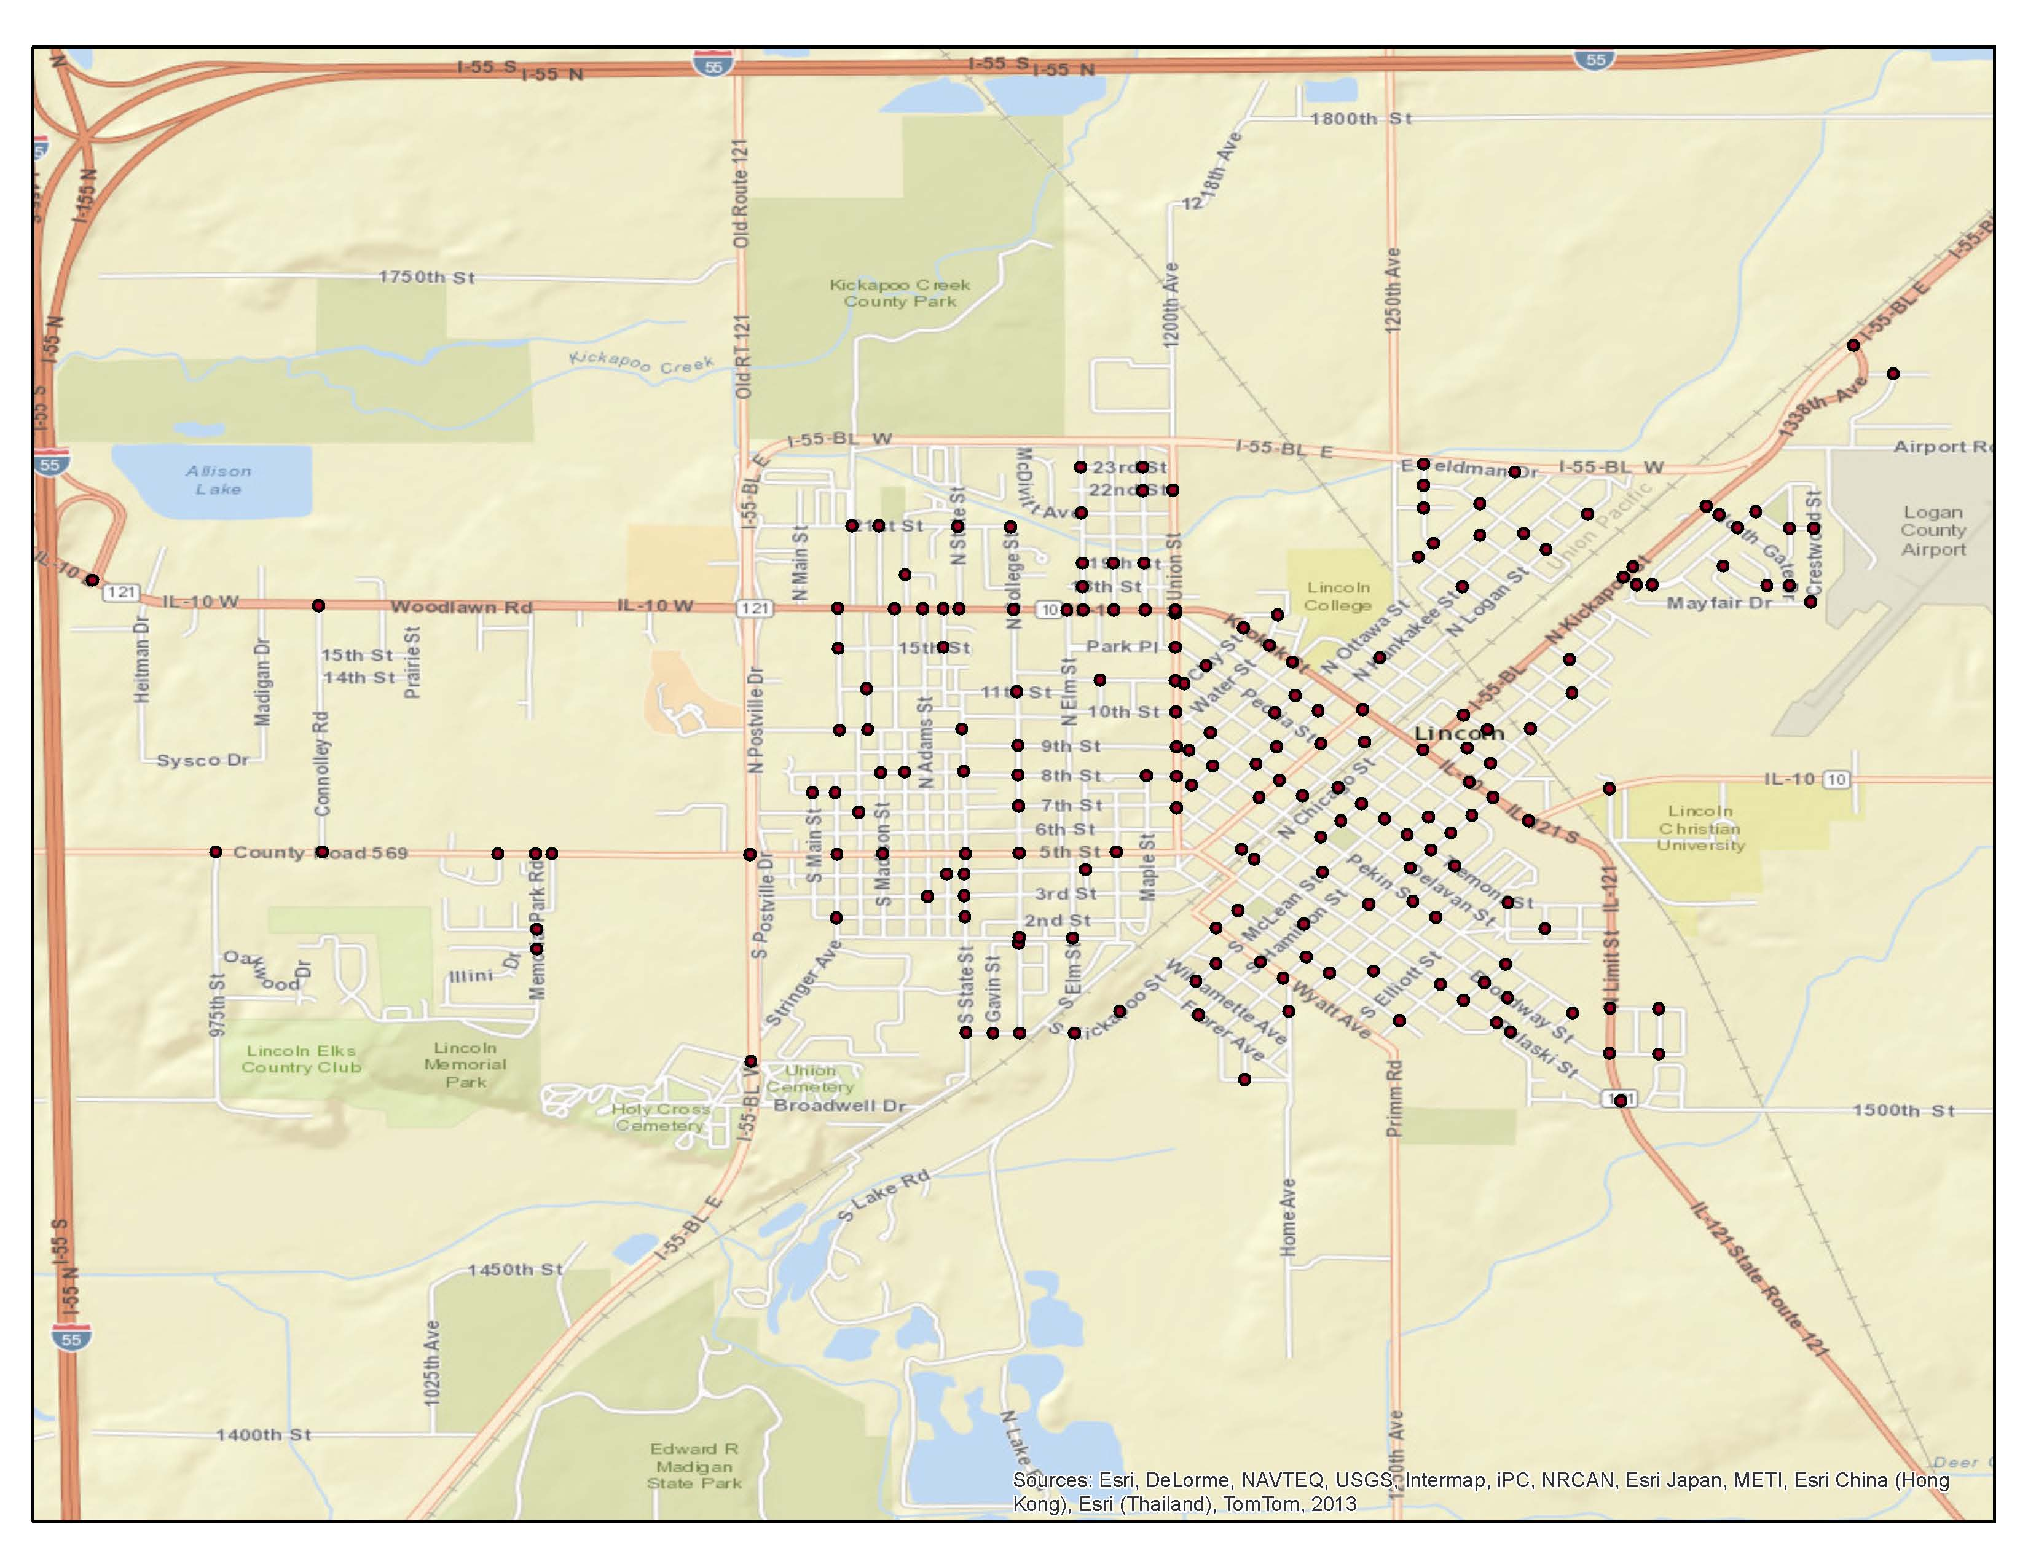
Q26: What is the nearest intersection to where you live?

Slide 59
Engagement and Demographics

Slide 60
Q27: Overall, how interested are you in City of Lincoln issues?
Not at all interested Very Interested

Slide 61
Q28: How well-informed are you about issues in the City of Lincoln?
Not at all informed Very Informed

Slide 62
Q29: How many years have you lived in City of Lincoln?

Slide 63
Q 30: If less than 5 years, where did you live previously? (City and State)

Slide 64
Q31: What is your current employment status?

Slide 65
Q32: If employed please indicate where you currently work.

Slide 66
Q33: What is the highest level of education you have completed?

Slide 67
Q34: How many children under the age of 18 live in your household?

Slide 68
Q35: What is your age group?

Slide 69
Q36: What is your gender?

Slide 70
Who are the City’s stakeholders?
If you were to leave Lincoln and not return for 10 years, what would you like to have changed? What would you like to stay the same?
What makes you proud of Lincoln?
What concerns you most about the future of Lincoln?

